Slide 1
Transactions in Spring

Slide 2
Agenda
Into to transaction management
Functions of Transaction Managers
Local/Global Transaction Managers
TransactionManagers supported by Spring Framework
Transaction definition
Programmatic transaction management
Declarative transaction management

Slide 3
Consider example
JdbcTemplate (see last lesson) is not a substitute for transaction management
Consider:
userService.updateUser will operate in a database transaction and if accountService.updateUserAccount(user) fails then userService.updateUser will not rollback
userService.updateUser(user);
accountService.updateUserAccount(user);

Slide 4
Transaction Manager Functions
A transaction manager is the part of an application that is responsible for coordinating transactions across one or more resources.
The responsibilities of the transaction manager are as follows:
Demarcation—starting and ending transactions using begin, commit, and rollback methods.
Managing the transaction context—a transaction context contains the information that a transaction manager needs to keep track of a transaction. The transaction manager is responsible for creating transaction contexts and attaching them to the current thread.
Coordinating the transaction across multiple resources—enterprise-level transaction managers typically have the capability to coordinate a transaction across multiple resources. This feature requires the 2-phase commit protocol and resources must be registered and managed using the XA protocol (see X/Open XA standard).
Recovery from failure—transaction managers are responsible for ensuring that resources are not left in an inconsistent state, if there is a system failure and the application crashes. In some cases, manual intervention might be required to restore the system to a consistent state.

Slide 5
Types of Transaction Managers
Local. A local transaction manager is a transaction manager that can coordinate transactions over a single resource only. In this case, the implementation of the transaction manager is typically embedded in the resource itself and the Spring transaction manager is just a thin wrapper around this built-in transaction manager
Global, coordinate transactions over multiple resources
Distributed

Slide 6
Local Transaction Manager
Based on “local” (resource) transactions which are tied to Connection
Local Transaction Manager is built over connection pool
This transaction manager will associate Connections with thread-bound transactions itself, according to the specified propagation behavior. It assumes that a separate, independent Connection can be obtained even during an ongoing transaction

Slide 7
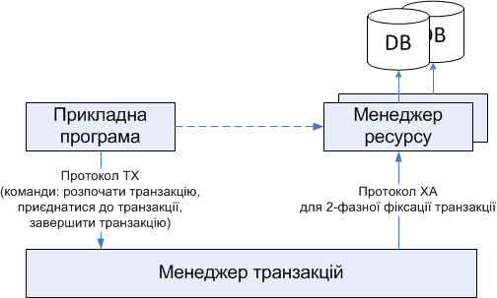
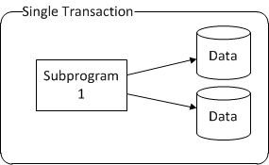
Global Transaction Manager
Учасники транзакції
Прикладна програма
Менеджер ресурсу
Менеджер транзакцій

Slide 8
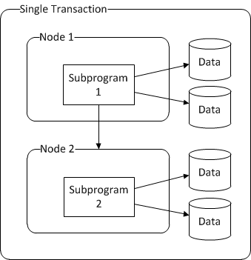
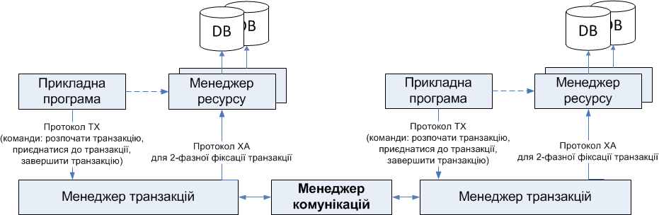
Distributed Transaction Manager
Учасники розподіленої транзакції
Прикладна програма
Менеджер ресурсу
Менеджер транзакцій
Менеджер комунікації з іншими менеджерами транзакцій
Для розподілених транзакцій, кожний сервер має локальний менеджер транзакцій, який взаємодіє з іншими менеджерами транзакцій за допомогою менеджера комунікацій

Slide 9
Java Transaction API (JTA)
Java Transaction API (JTA) – це API, яке надається програмісту для управляти транзакціями на платформі Java EE в інфраструктурі application server
JTA - це специфікація інтерфейсу взаємодії між прикладною програмою, менеджером транзакцій, менеджером ресурсів
JTA-транзакція (UserTransaction) – це транзакція, яка управляється та координується платформою Java EE.
JTA визначено в пакеті
javax.transaction.*
UserTransaction – один із основних класів JTA. Це «міст» між прикладною програмою та менеджером транзакцій

Slide 10
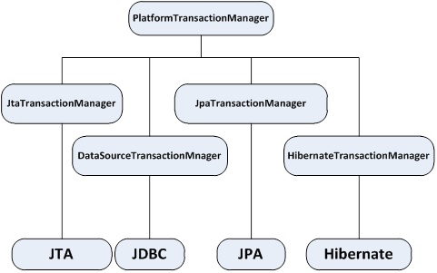
Transaction Managers supported by Spring
Types of transaction manager supported by Spring Framework:
Native (local) transaction managers (like JDBC DataSourceTransactionManager, Hibernate HibernateTransactionManager, etc)
Local JTA-based transaction manager (typically J2EE servers or 3rd party JTA-providers)
Switching between these strategies is just a matter of configuration!
Consistent programming model
Transaction manager is a configuration choice, application code is decoupled from transaction infrastructure

Slide 11
Native transaction managers
Work only against a single database, no distributed transactions
Typical scenarios:
Standalone application
Integration test
J2EE web application running on Tomcat
Examples of native transaction managers
DataSourceTransactionManager
HibernateTransactionManager

Slide 12
JTA transaction managers
Local transaction managers are supported
Scenario:
J2EE server's JTA subsystem
3rd party JTA-provider
3rd party JTA provider for Spring Boot application
*Distributed transactions (propagation of transaction context remotedly) are not supported.

Slide 13
PlatformTransactionManager – way to obtain and manage transactions
public interface PlatformTransactionManager {
TransactionStatus getTransaction(
TransactionDefinition definition) throws TransactionException;
void commit(TransactionStatus status) throws TransactionException;
void rollback(TransactionStatus status) throws TransactionException;
}

Slide 14
Transaction Definition
Propagation behavior
Isolation level
Read-only flag
Transaction timeout
Transaction name
DefaultTransactionDefinition def = new DefaultTransactionDefinition(); def.setIsolationLevel(TransactionDefinition.ISOLATION_DEFAULT); def.setPropagationBehavior(TransactionDefinition.PROPAGATION_REQUIRES_NEW); def.setReadOnly(false); def.setTimeout(0); TransactionStatus status=txManager.getTransaction(def);

Slide 15
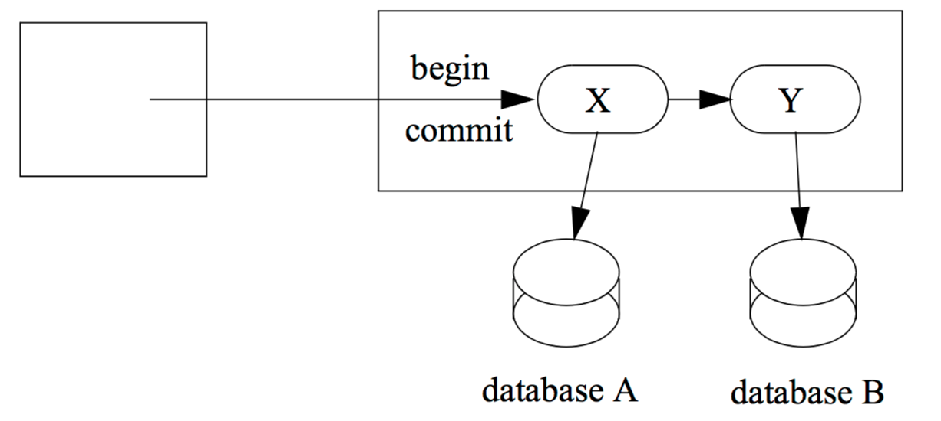
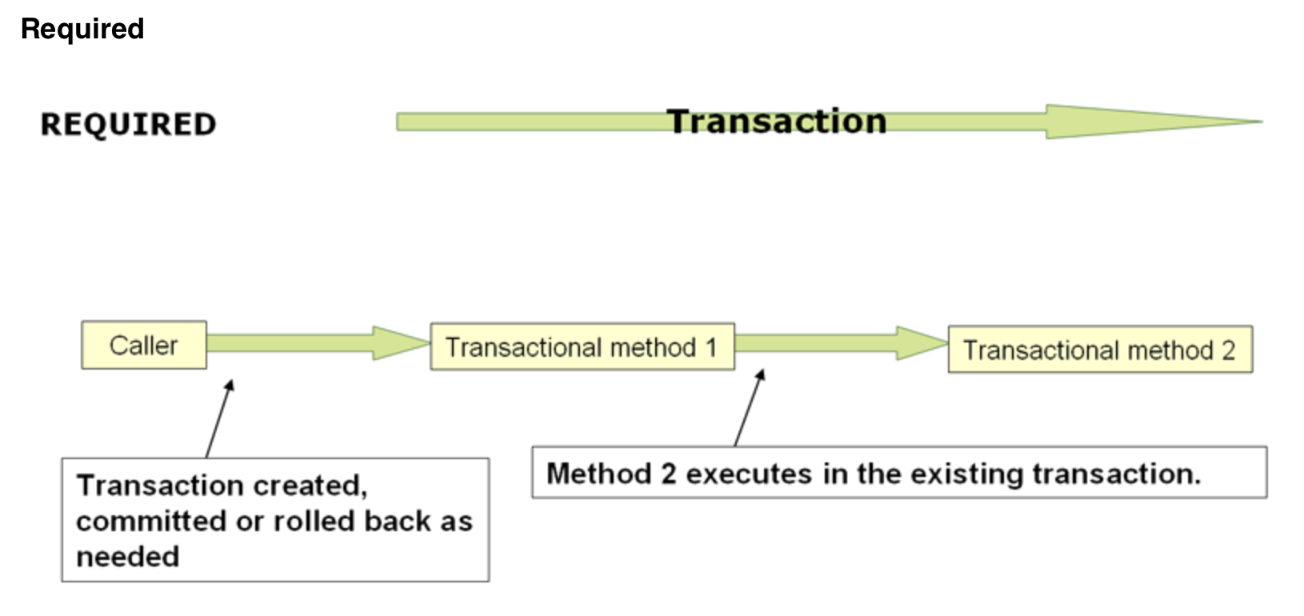
Transaction propagation

Slide 16
Transaction Propagation
Атрибут | Транзакція клієнта | Трансакція, асоційована з бізнес-методом
REQUIRED | Відсутня | T2
 | T1 | T1
REQUIRES_NEW | Відсутня | T2
 | T1 | T2
NOT_SUPPORTED | Відсутня | Відсутня
 | T1 | Відсутня
SUPPORTS | Відсутня | Відсутня
 | T1 | T1
MANDATORY | Відсутня | Помилка
 | T1 | T1
NEVER | Відсутня | Відсутня
 | T1 | Помилка
NESTED (if supported by underlying tx manager | T1 | T2
Позначимо:
T1 – транзакція, розпочата клієнтом
T2 – транзакція, ініційована контейнером

Slide 17
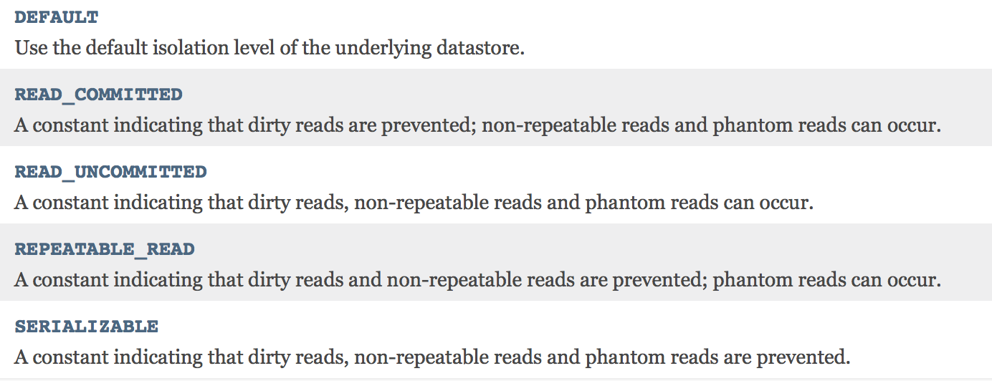
Transaction Isolation

Slide 18
Programmatic Transaction Demarcation

Slide 19
Practical Example, Programmatic Transaction Demarcation
JDBCTemplate + programmatic transaction demarcation
The Spring Framework provides two means of programmatic transaction management:
Using the TransactionTemplate
Using a PlatformTransactionManager implementation directly

Slide 20
Transaction demarcation via Platform Transaction manager
See example JdbcTemplate + PlatformTransactionManager
Direct access to transaction

Slide 21
TransactionTemplate
JdbcTemplate + TransactionTemplate
Please pay attention how transaction is rolled back in this case
transactionTemplate.execute(new TransactionCallbackWithoutResult() {
protected void doInTransactionWithoutResult(TransactionStatus status) {
try {
updateOperation1();
updateOperation2();
} catch (SomeBusinessExeption ex) {
status.setRollbackOnly();
}
}
});

Slide 22
Declarative Transaction Demarcation

Slide 23
@Transactional over class (method)
@EnableTransactionManagement in configuration

Slide 24
@Transactional
public class PetStoreImpl implements PetStoreFacade { private OrderDao orderDao; private ItemDao itemDao; ... public void setOrderDao(OrderDao orderDao) { this.orderDao = orderDao; } public void setItemDao(ItemDao itemDao) { this.itemDao = itemDao; } ... @Transactional public void insertOrder(Order order) { this.orderDao.insertOrder(order); this.itemDao.updateQuantity(order); } }

Slide 25
@Transactional works via AOP Proxy

Slide 26
How to rollback declarative transaction?
via properties of @Transactional
Property | Type
rollbackFor | array of Class objects, must be derived from Throwable
rollbackForClassname | array of String class names. Classes must be derived from Throwable
noRollbackFor | array of Class objects, must be derived from Throwable
noRollbackForClassname | array of String class names, must be derived from Throwable

Slide 27
Example
@Transactional(readOnly=true)
interface TestService {
@Transactional(readOnly=false,
rollbackFor=DuplicateOrderIdException.class)
void createOrder(Order order) throws DuplicateOrderIdException ;
List queryByCriteria(Order criteria);
}

Slide 28
Bibliography
Transaction Management with the Spring Framework, Jürgen Höller http://slideplayer.com/slide/4793614/
Transaction Management http://docs.spring.io/spring-framework/docs/4.2.x/spring-framework-reference/html/transaction.html#transaction-strategies
What is a Transaction Manager? https://access.redhat.com/documentation/en-US/Fuse_ESB_Enterprise/7.1/html/EIP_Transaction_Guide/files/TxnManagers-WhatIs.html

Slide 29
Домашечка
Добавить поддержку транзакций в свое приложение

